Slide 1
secure data hiding in Images using steganography
CAPSTONE PROJECT
Presented By: Arpitha M
Student Name : Arpitha M
College Name : NMAM Institute of Technology Nitte
& Department : Information Science and Engineering

Slide 2
OUTLINE
Problem Statement
Technology used
Wow factor
End users
Result
Conclusion
Git-hub Link
Future scope

Slide 3
Problem Statement
Steganography is a technique for concealing data within images to ensure secure communication
Uses LSB (Least Significant Bit) or other embedding techniques to hide information in image pixels.
Enhances data confidentiality by making hidden information undetectable to the human eye.
Used in secure communication, watermarking, and digital forensics to prevent unauthorized access.

Slide 4
Technology used
Programming Language used: Python
Image Processing Library: OpenCV
File handling library: OS
Pixel modifications library: numpy
IDE: Visual Studio Code
Platform: Windows 11

Slide 5
Wow factors
Seamless Encryption & Decryption: This project integrates both encryption and decryption into a single workflow, eliminating the need for separate tools and ensuring a smooth user experience.
Undetectable Image-Based Steganography: Unlike traditional methods that distort images, this approach hides messages within pixel values without noticeable alterations, maintaining high secrecy.
Secure Passcode Protection: Decryption requires a passcode, ensuring that even if someone accesses the encrypted image, they cannot retrieve the hidden message without authorization.
Efficient Pixel Encoding: The project strategically distributes ASCII values across RGB channels, making it more storage-efficient than standard LSB methods while minimizing data loss.

Slide 6
End users
Government, Military & Intelligence Agencies – Used for covert operations, secure messaging, and classified data exchange in defense and national security.
Cybersecurity Professionals – Can leverage this technique for secure data transmission and preventing data leaks.
Journalists & Whistleblowers – Enables safe communication of sensitive information without raising suspicion.
Educational Institutions & Researchers – Helps in teaching cryptography and steganography while exploring advanced security techniques.
General Users & Privacy Enthusiasts – Individuals seeking private and secure communication for personal or professional use.

Slide 7
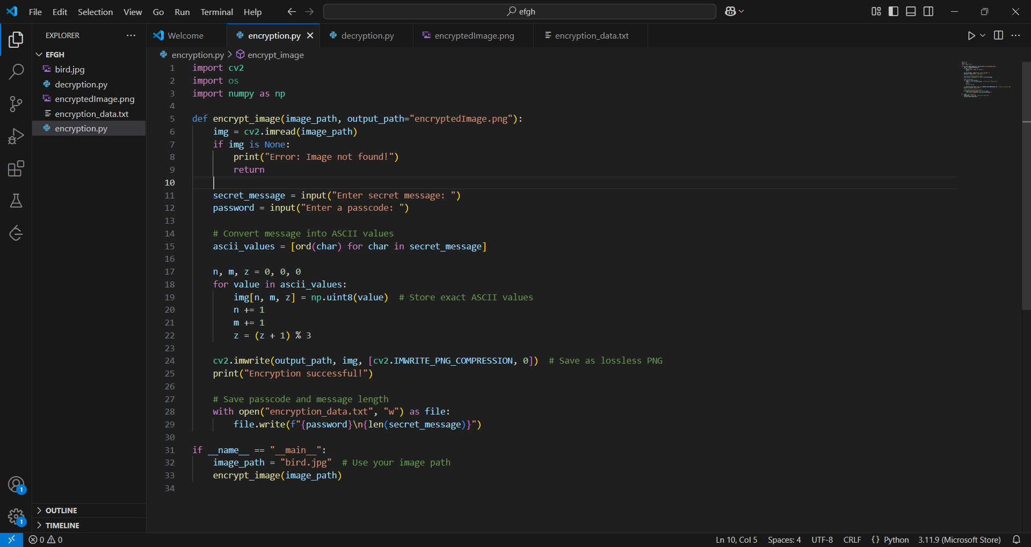
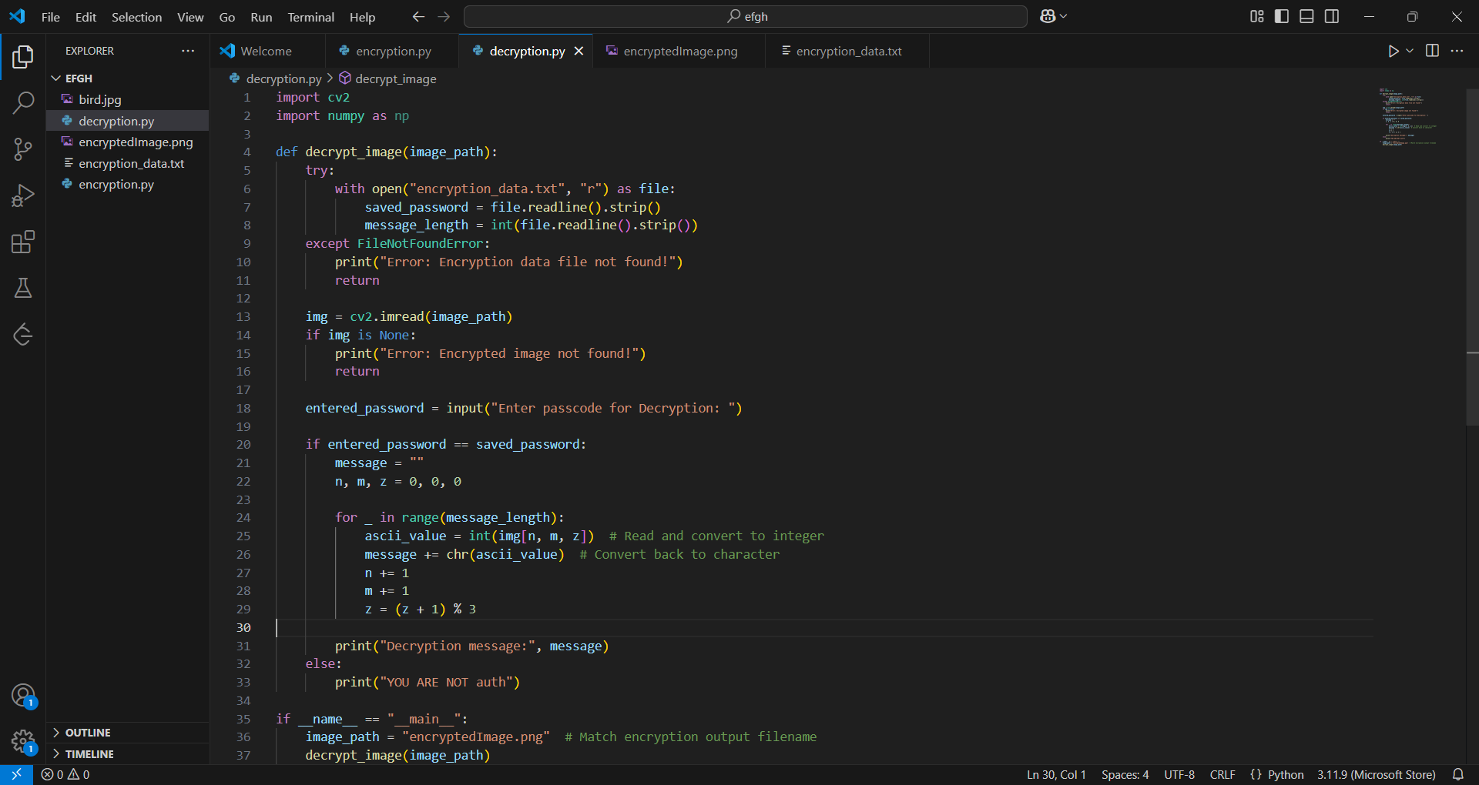
Results
Figure(i) Encryption Code
Figure(ii) Decryption Code

Slide 8
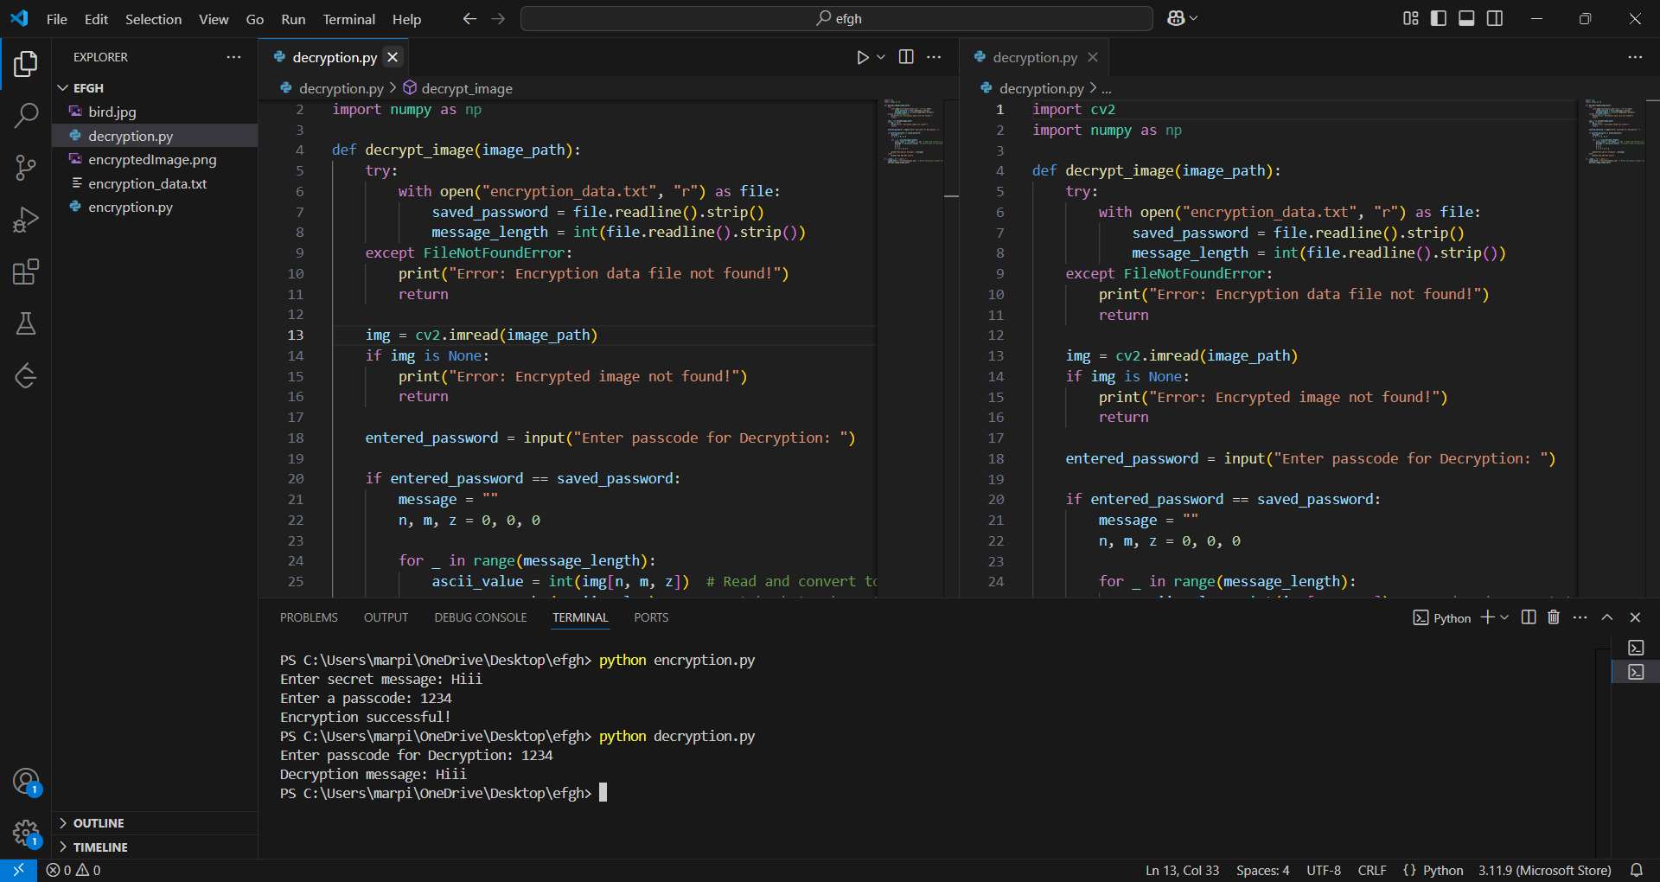
Results
Fig(iii) Output

Slide 9
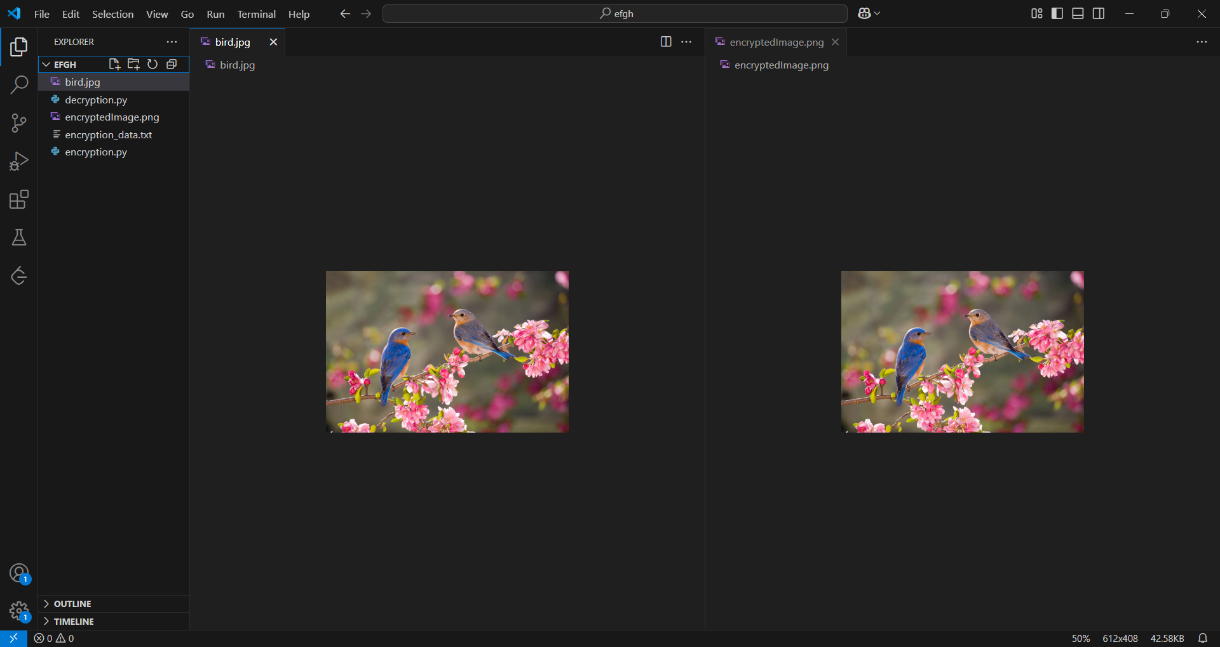
Results
Figure(iv) original image (bird.ipg) and encrypetedimage

Slide 10
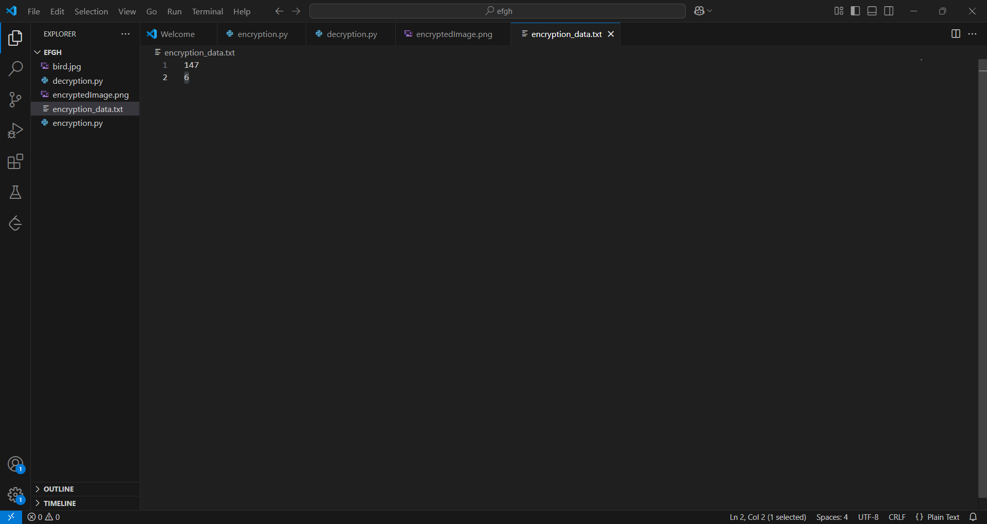
Results
Fig(v) Text file contains secret code and its length

Slide 11
Conclusion
This project successfully addresses the problem of secure and hidden communication by implementing image-based steganography with encryption and passcode protection. Unlike traditional data-hiding techniques, this method ensures that sensitive messages remain undetectable while maintaining the integrity of the original image.
By integrating efficient pixel encoding, passcode-based security, and minimal distortion, the project offers a reliable, user-friendly, and stealthy way to transmit confidential information. This makes it valuable for military, government, cybersecurity professionals, businesses, and privacy-conscious individuals.

Slide 12
GitHub Link
https://github.com/ArpithaM21/secure-data-hiding-in-images-using-steganography.git

Slide 13
THANK YOU

